Slide 1
EECE301: Signals and Systems
Noise Analysis & Filtering of an Audio Signal
PD2 Section M1 Group 5
Yousef AlAbdulrazzaq (75018) Jamal AlEleawah (10094770) Abdelrahman Hussein (10095516)
Instructor: Dr. Yazid Khattabi
12 July 2026
Jamal AlEleawah

Slide 2
Table of Contents
1. Introduction
2. Project Objectives
3. Criteria & Constraints
4. Assigned Code & Audio
5. MATLAB Program Overview
6. Program Flowchart
7. Signal Processing Methodology
8. Results & Analysis
9. Discussion
10. Reflections on the Team
11. Conclusion & Future Remarks
12. References
Jamal AlEleawah

Slide 3
Introduction
A clean audio clip has been corrupted with high-frequency noise, and we recover it using frequency analysis and filtering.
PD1 studied a continuous-time signal under noise; here we extend that to a discrete-time MATLAB simulation on real audio.
Our assignment (Table 2): Section M1, Group 5, runs Code3 on AudioB.
The work rests on two tools: Fourier Transform (FFT) spectral analysis and a low-pass filter.
Jamal AlEleawah

Slide 4
Project Objectives
Characterize the assigned audio signal in both time and frequency domains.
Model additive two-tone interference and observe its spectral signature.
Design and apply a low-pass filter to suppress out-of-band noise.
Interpret the filter’s effect and justify every result using Fourier theory.
Reconstruct and evaluate the filtered signal, and identify the method’s limits.
Jamal AlEleawah

Slide 5
Criteria & Constraints
Design Criteria
Constraints
Recover the desired audio band with minimal distortion.
Attenuate the out-of-band tones strongly and measurably.
Keep the filter transparent inside the signal band.
Sampling rate is fixed by the file: Fs = 48 kHz (Nyquist 24 kHz).
Use the provided code and audio as-is; only pick the assigned pair.
One fixed low-pass filter (order 15, fc = 6 kHz), no adaptive or staged filtering.
Jamal AlEleawah

Slide 6
Assigned MATLAB Code & Audio File
Our assigned pair is Code3 running on AudioB (Section M, odd, Group 5).
AudioB: 3.624 s, Fs = 48 kHz, mono, 173,952 samples, peak amplitude 0.97.
Code3 adds two tones, 0.024·sin(2π·5000t) + 0.048·sin(2π·10000t), at 5 kHz and 10 kHz.
The code selects the file through audioread; we enable the AudioB line and run it unmodified.
The 5 kHz tone lands inside the audio band while the 10 kHz tone lands outside it, and that single fact drives every result.
Jamal AlEleawah

Slide 7
MATLAB Program Overview
A single linear pipeline, with no loops or branching beyond file selection:
1. Read audio audioread → signal s, rate Fs
2. Corrupt add two-tone interference
3. Inspect time-domain plot + play
4. Transform fft → fftshift → two-sided spectrum (2|X|/N)
5. Design filter butter(15, 6000/(Fs/2), 'low'); view freqz / impz
6. Filter & re-analyze filter → one-sided spectrum of output
7. Reconstruct ifft → plot + play filtered
Yousef AlAbdulrazzaq

Slide 8
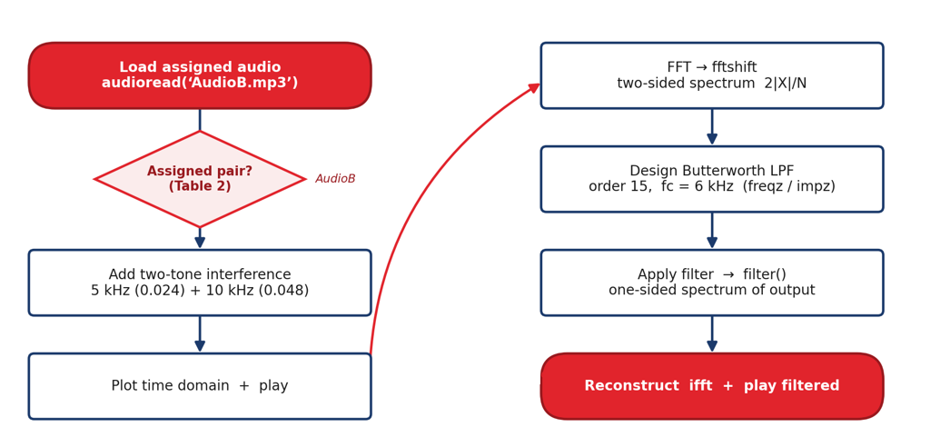
Program Flowchart
Yousef AlAbdulrazzaq

Slide 9
Methodology: Sampling & the Nyquist Limit
At Fs = 48 kHz, samples land every ts = 1/Fs ≈ 20.8 µs.
The Nyquist frequency Fs/2 = 24 kHz is the highest frequency we can represent.
Our highest tone, 10 kHz, sits far below 24 kHz, so nothing aliases.
So both tones appear at their true frequencies, 5 kHz and 10 kHz.
Because sampling sits well above Nyquist, the discrete spectrum faithfully represents the true signal.
Yousef AlAbdulrazzaq

Slide 10
Methodology: Spectrum & Amplitude Scaling
Fourier Transform (FFT) gives the DFT, and fftshift re-centers 0 Hz for a two-sided view over [−Fs/2, Fs/2).
Scaling by 2|X|/N maps a sine of amplitude A to a spectral peak of height A.
The measured peaks, 0.024 at 5 kHz and 0.048 at 10 kHz, match the noise we added.
This is the bridge from the CTFT to the DFT: the discrete spectrum approximates the continuous transform.
Every measured peak matches the amplitude we injected.
Yousef AlAbdulrazzaq

Slide 11
Methodology: Low-Pass Filter Design
butter(15, 6000/(Fs/2), 'low') builds a 15th-order low-pass filter with a 6 kHz cutoff.
The cutoff normalizes to 6000/24000 = 0.25, a quarter of Nyquist.
The passband stays maximally flat, rolloff is monotonic, and the gain is exactly −3 dB at fc.
It is stable (all poles inside the unit circle, max |pole| = 0.93) and causal.
Order 15 gives a transition steep enough to separate 5 kHz from 10 kHz cleanly.
Yousef AlAbdulrazzaq

Slide 12
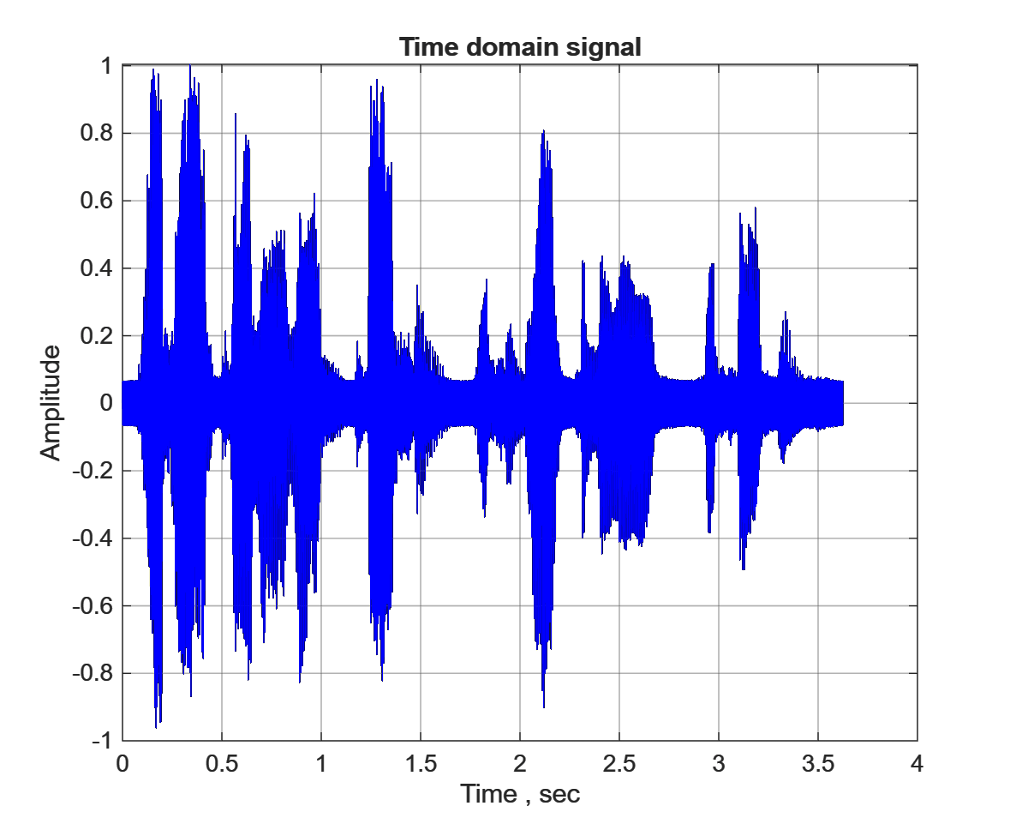
Results: Time Domain
The full corrupted signal, spanning 3.62 s.
The noise is invisible in time: the tones (0.024 and 0.048) are tiny next to speech near 0.97.
The noisy peak reaches 1.004, just grazing the playback clip limit.
The time view tells us nothing, so we look at the frequencies instead.
The time domain hides narrowband tones; only the spectrum reveals them.
Yousef AlAbdulrazzaq

Slide 13
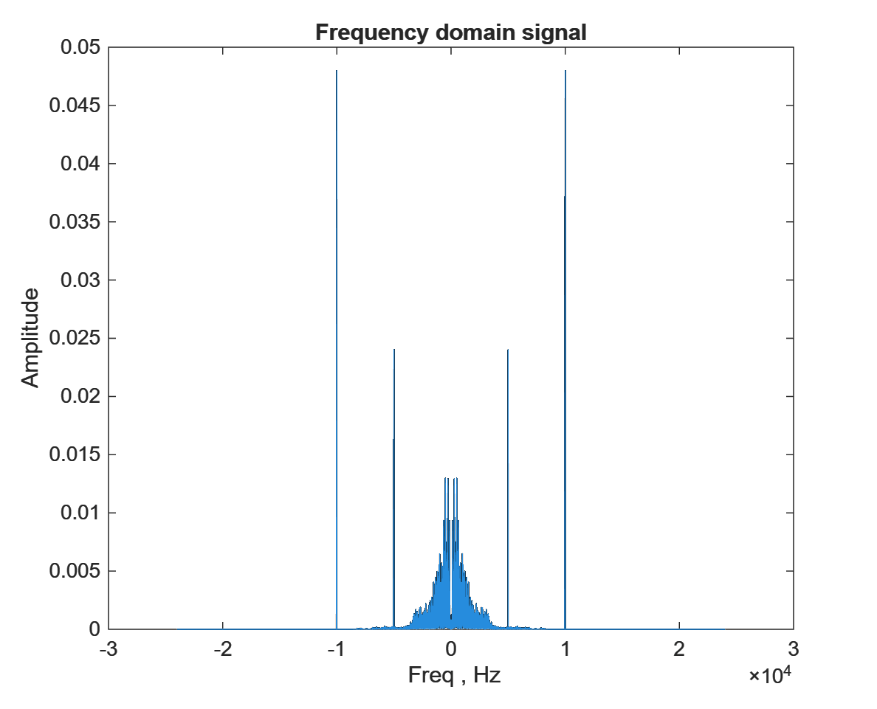
Results: Two-Sided Spectrum
Two sharp spikes appear at ±5 kHz and ±10 kHz, the hidden tones now made obvious.
Their heights, 0.024 and 0.048, confirm the 2/N amplitude scaling.
The desired audio sits below ~2 to 3 kHz (baseband lump near 0 Hz).
That clear separation makes a low-pass filter the natural tool.
The frequency domain turns an invisible problem into an obvious one.
Abdelrahman Hussein

Slide 14
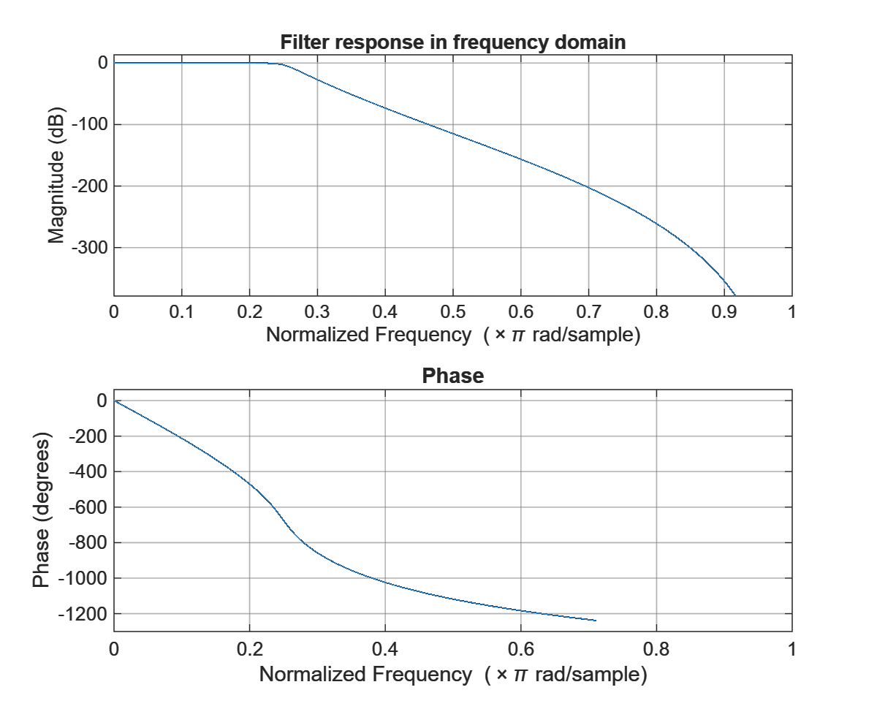
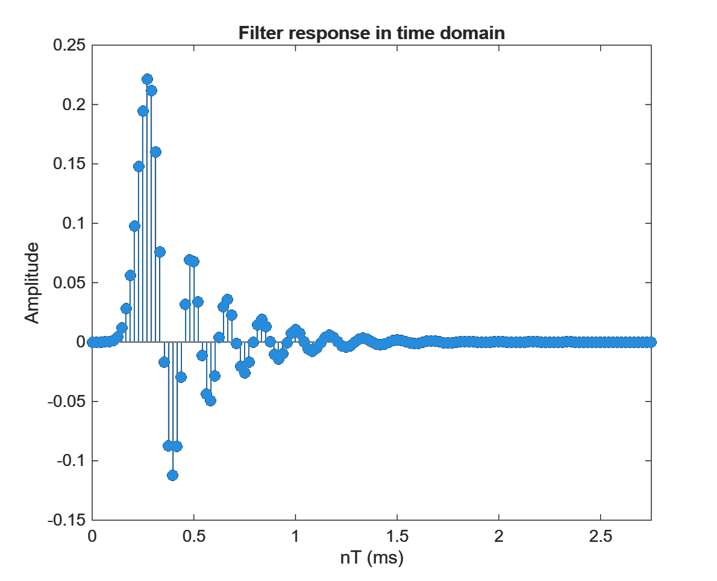
Results: Filter Response
Flat passband to fc, then steep rolloff: −3 dB at 6 kHz, ≈−80 dB at 10 kHz; impulse response decays (stable, causal).
The gain |H(f)| at each tone predicts its fate: 5 kHz barely touched, 10 kHz crushed by 80 dB.
Abdelrahman Hussein

Slide 15
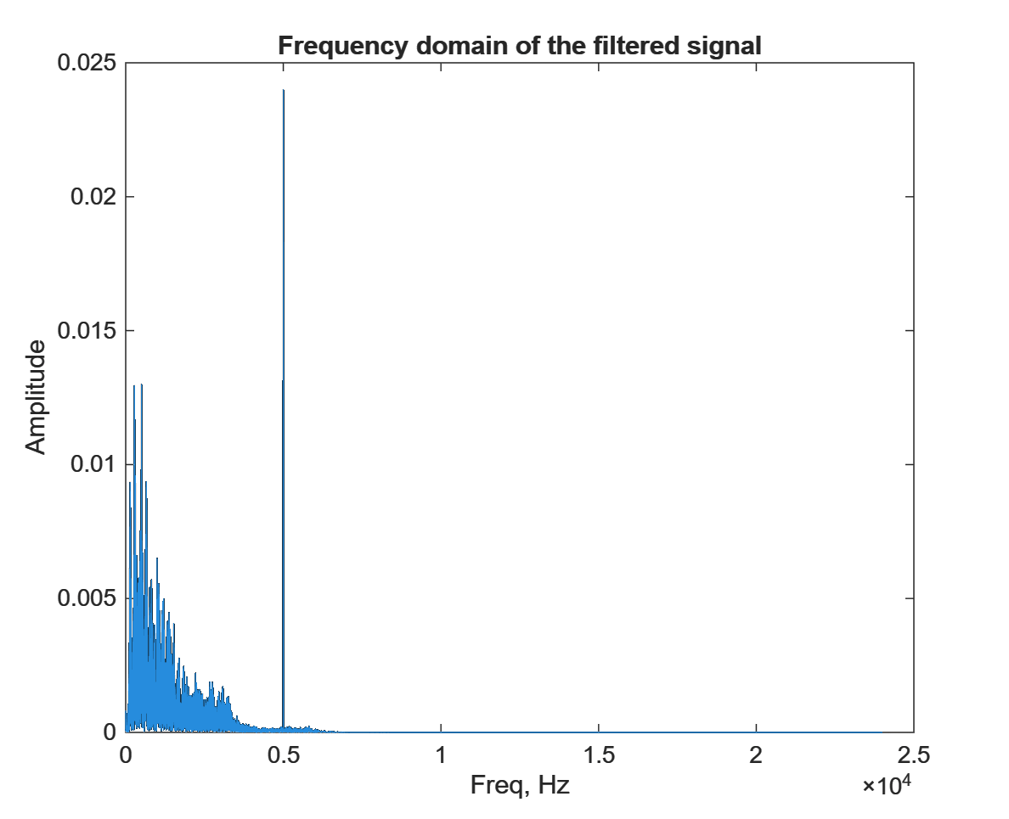
Results: Filtered Spectrum
The 10 kHz tone drops from 0.048 to 4.7×10⁻⁶ (−80 dB), effectively gone.
The 5 kHz tone stays at 0.024, passing through untouched.
The desired band is preserved: the filter removes only 0.05% of the audio energy.
You can hear it: the 10 kHz whistle is gone, but the 5 kHz whistle remains.
A low-pass filter removes only the out-of-band tone; the in-band tone survives.
Abdelrahman Hussein

Slide 16
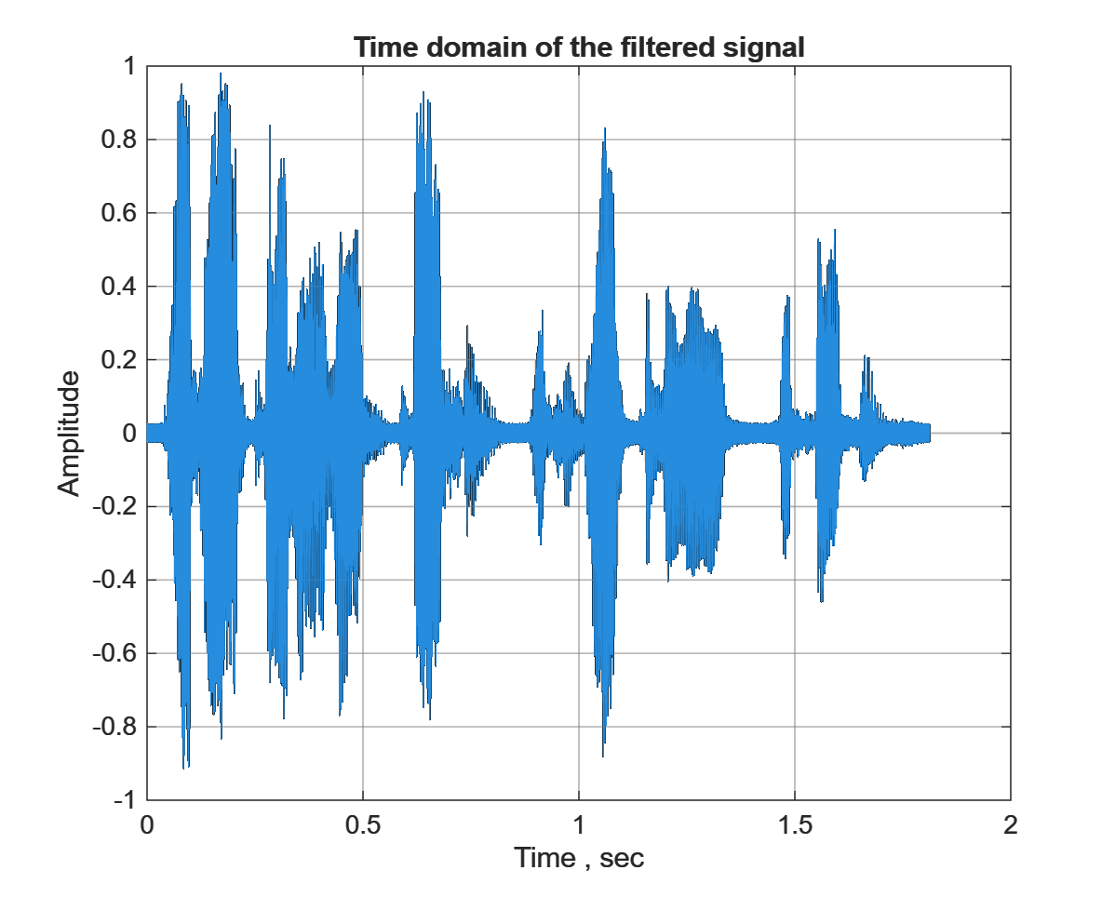
Results: The Reconstruction Artifact
The code rebuilds the signal by taking the inverse Fourier Transform (ifft) of the one-sided spectrum.
That inverse comes out complex and half-length (max |imag| = 1.22, dropped by real()).
So the "time-domain filtered" plot is an artifact, spanning 1.81 s instead of 3.62 s.
The right fix is to plot the filter output directly, since it is already the time signal.
We explain the plot rather than trust it; the filter output itself is the real signal.
Abdelrahman Hussein

Slide 17
Discussion
Fourier theory predicts every result: how far a tone drops is just the filter's gain at that frequency.
A low-pass filter cannot remove in-band interference: the 5 kHz tone sits inside the 6 kHz passband, so it survives by design, not by error.
The 6 kHz cutoff is the right call for out-of-band noise: it keeps 99.95% of the audio energy while removing the 10 kHz tone.
This is the convolution theorem at work: filtering in time equals multiplication in frequency (X·H).
The surviving tone is not a filter failure; it is a fundamental limit of low-pass filtering.
Abdelrahman Hussein

Slide 18
Reflections on the Team
Work was divided by pipeline stage: signal setup, filter design, and results/analysis.
The project reinforced the link between PD1 theory (CTFT, filtering) and PD2 simulation.
Main takeaway: spectral thinking makes an “invisible” time-domain problem obvious.
Coordination via a shared MATLAB run and review; each member owns their section for Q&A.
Abdelrahman Hussein

Slide 19
Conclusion & Future Remarks
Conclusion
Future Remarks
Frequency analysis revealed the hidden interference.
A 15th-order low-pass filter removed the 10 kHz tone with negligible audio distortion.
The 5 kHz in-band tone persists, exposing the limit of a single low-pass stage.
Add a band-stop / notch filter at 5 kHz to remove the in-band tone.
Use FIR (linear-phase) filtering for distortion-controlled suppression.
Explore adaptive filtering for selective, signal-aware noise removal.
Abdelrahman Hussein

Slide 20
References
Oppenheim, A. V., & Willsky, A. S. (1997). Signals and Systems (2nd ed.). Prentice Hall.
MathWorks. (2026). butter, freqz, filter, fft. MATLAB Documentation. https://www.mathworks.com/help
EECE301 Course Project: Part 2 Description (Summer 2026). American University of the Middle East.
Abdelrahman Hussein

